Slide 1
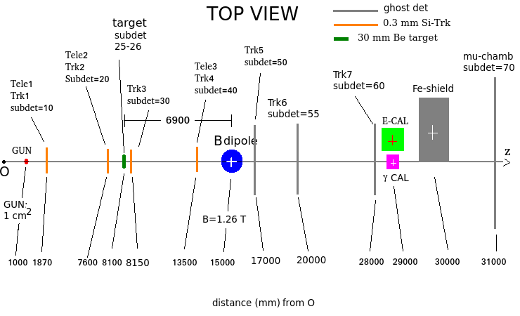
μ⁻
50 positive x is 50
50 negative x is 51, z(50) < z(51)
55 positive x is 55
55 negative x is 56, z(55) < z(56)
γ CAL is 60
E CAL is 61
sandwich CAL is 62

